Slide 1

Algebra 1
Unit 7, Lesson 2 Factoring a Trinomial With Algebra Tiles Volume 1, pg. 362

Slide 2


Benchmark
MA.912.AR.1.7
Rewrite a polynomial expression as a product of polynomials over the real number system.
volume 1, pg. 362

Slide 3
Integrated Mathematical Thinking and Reasoning Standards
MA.K12.MTR.2.1 Demonstrate understanding by representing problems in multiple ways.
MA.K12.MTR.3.1 Complete tasks with mathematical fluency.
MA.K12.MTR.4.1 Engage in discussions that reflect on the mathematical thinking of self and others.
MA.K12.MTR.5.1 Use patterns and structure to help understand and connect mathematical concepts.
volume 1, pg. 362

Slide 4


Learning Target
I can use algebra tiles to factor a trinomial with a leading coefficient of $1$.
volume 1, pg. 362

Slide 5

Warm-Up
volume 1, pg. 363

Slide 6
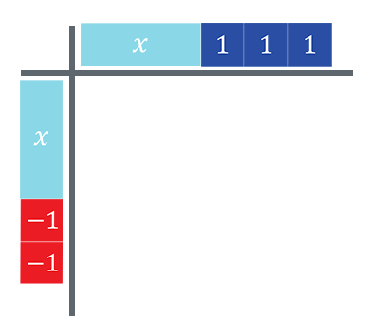
7.2.1 Warm-Up: Multiplying Binomials
An algebra tile mat is shown with two binomial factors.
volume 1, pg. 363

Slide 7
What are the two binomials represented?
What is the product of the two binomials?
volume 1, pg. 363

Slide 8

Exploration
volume 1, pg. 363

Slide 9

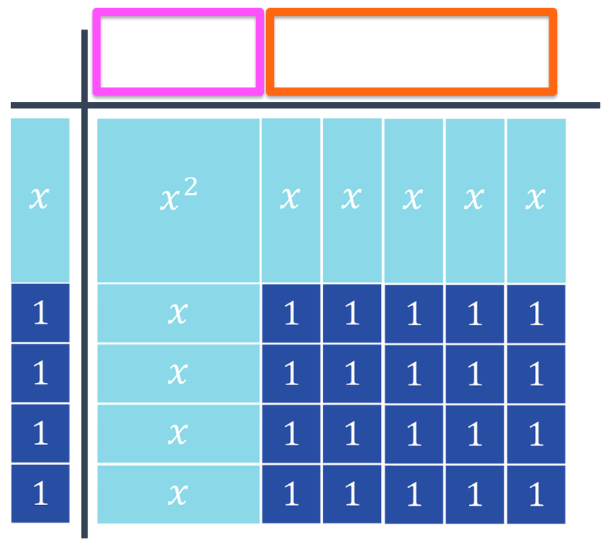
7.2.2 Exploration: Model Factoring With Algebra Tiles
An algebra tile mat is shown, where the product is the trinomial $x^{2}+9x+20$ and one of its factors is $\left(x+4\right)$.
volume 1, pg. 363

Slide 10
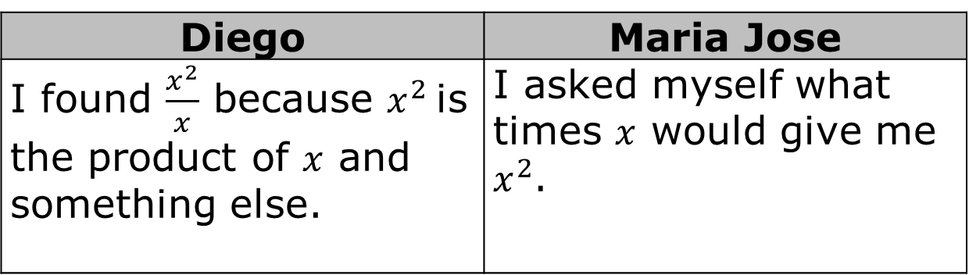
Diego and Maria Jose both justified how they determined what belonged in the pink box in the following ways.
Diego | Maria Jose
I found $\frac{x^{2}}{x}$ because $x^{2}$ is the product of $x$ and something else. | I asked myself what times $x$ would give me $x^{2}$.
volume 1, pg. 363

Slide 11

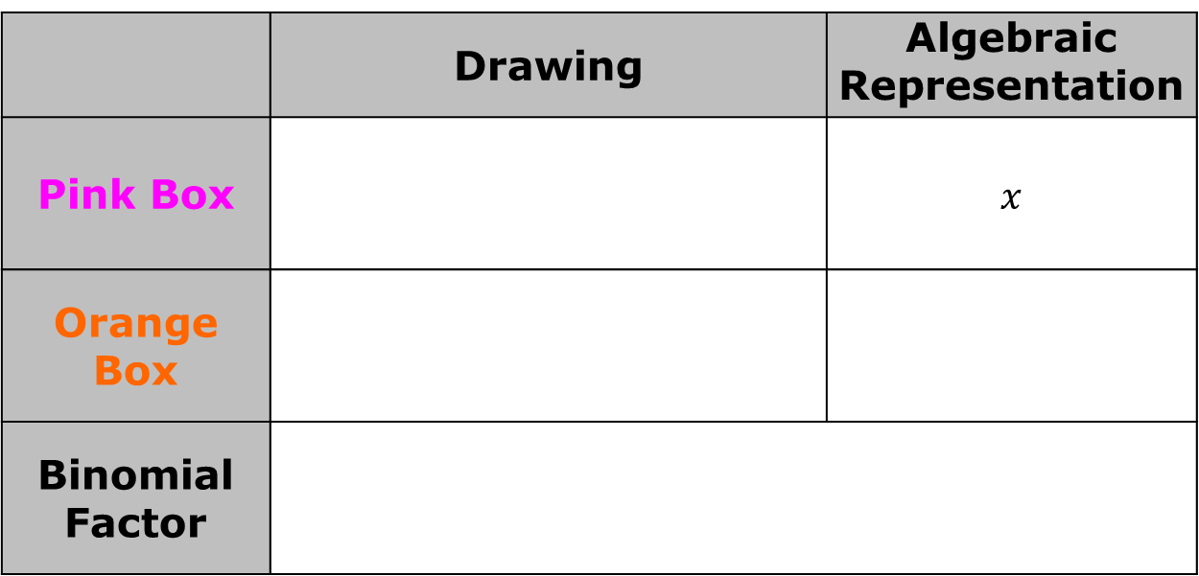
Discuss with your partner both justifications.
Use one of the methods to complete the binomial for the top bar of the algebra tile mat.
 | Drawing | Algebraic Representation
Pink Box |  | $$x$$
Orange Box
Binomial Factor
volume 1, pg. 364

Slide 12
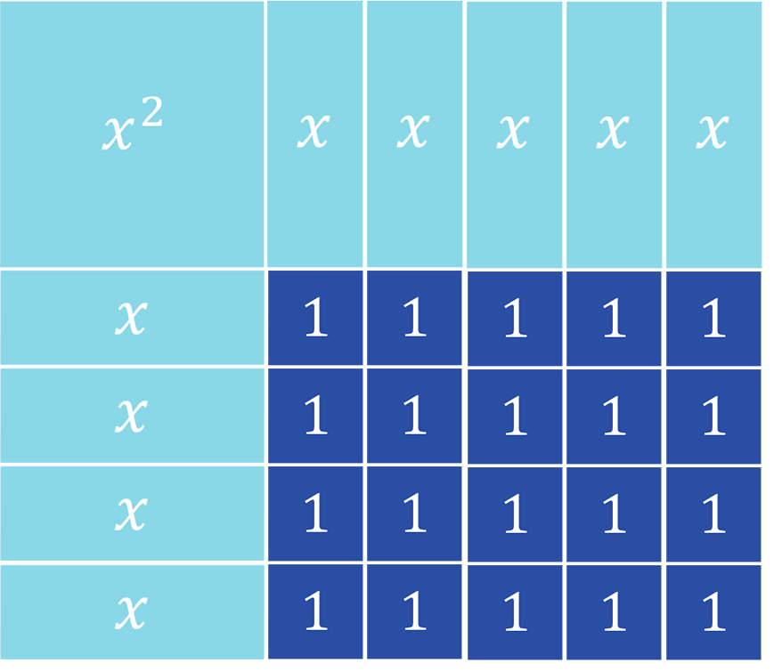

Discuss with your partner how to determine the two binomial factors when only given the product. Summarize your discussion.
The two binomials are the factors of the trinomial
$x^{2}+9x+20$. The process of finding the two binomials is called factoring.
volume 1, pg. 364

Slide 13
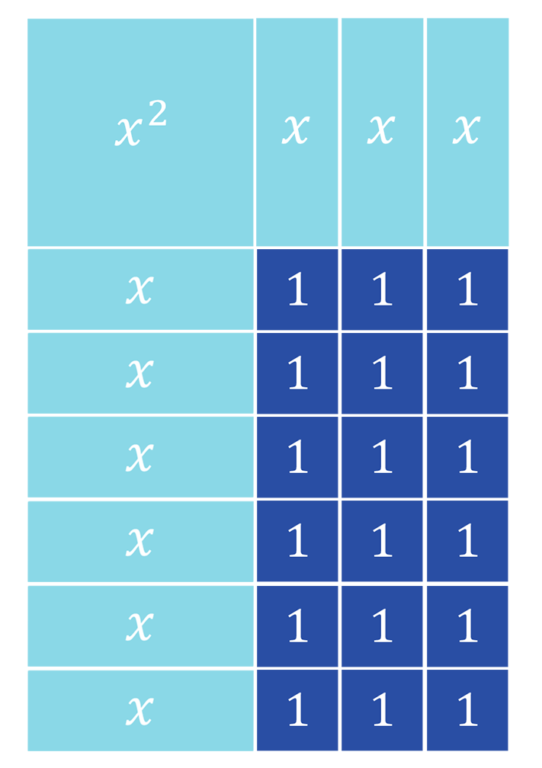
The algebra tiles shown represent the trinomial $x^{2}+9x+18$.
volume 1, pg. 365

Slide 14
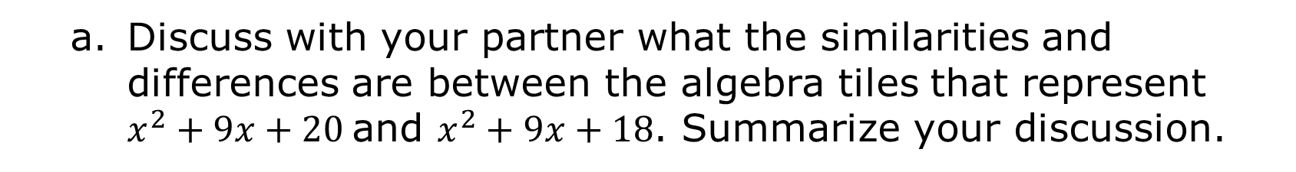
Discuss with your partner what the similarities and differences are between the algebra tiles that represent $x^{2}+9x+20$ and $x^{2}+9x+18$. Summarize your discussion.
Similarities
Differences
volume 1, pg. 365

Slide 15
What are the two binomials that are factors of $x^{2}+9x+18$?
volume 1, pg. 365

Slide 16
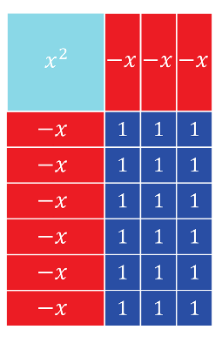
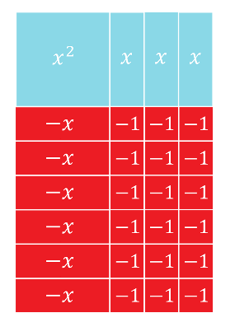
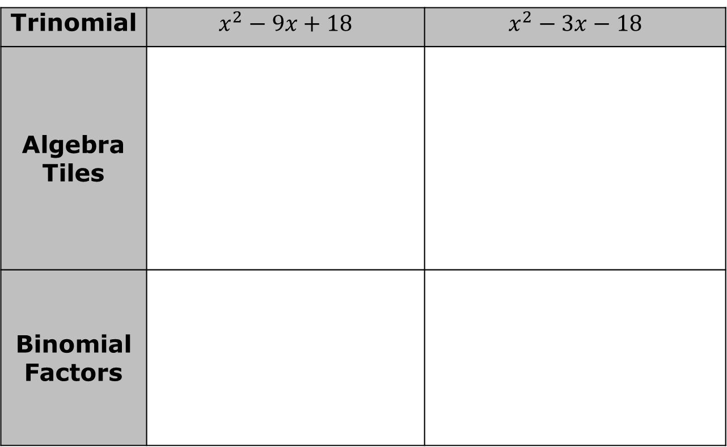
The table shows the algebra tile representation for two trinomials. Work with your partner to determine the two binomial factors.
Trinomial | $$x^{2}−9x+18$$ | $$x^{2}−3x−18$$
Algebra Tiles
Binomial Factors
volume 1, pg. 365

Slide 17
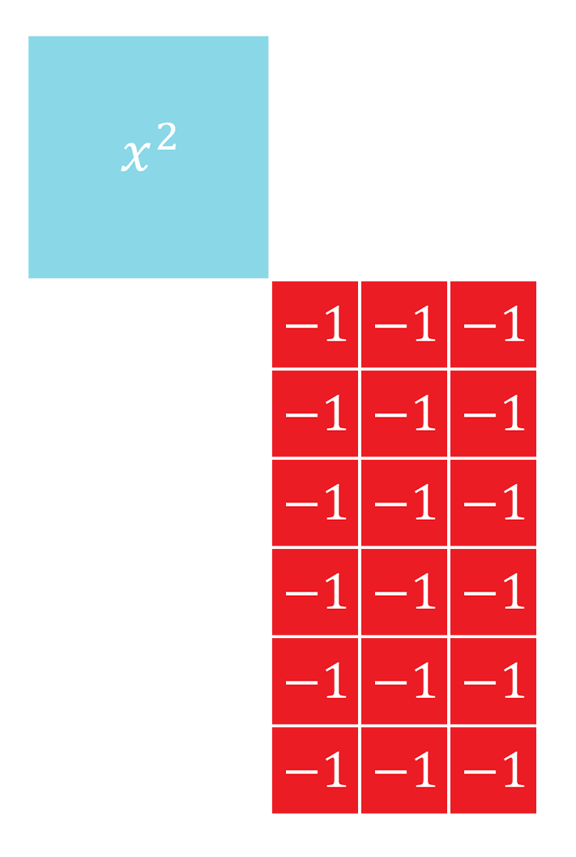
One common attribute of all of the algebra tile representations is that they are all rectangles.
Consider the following algebra tile representation.
volume 1, pg. 366

Slide 18
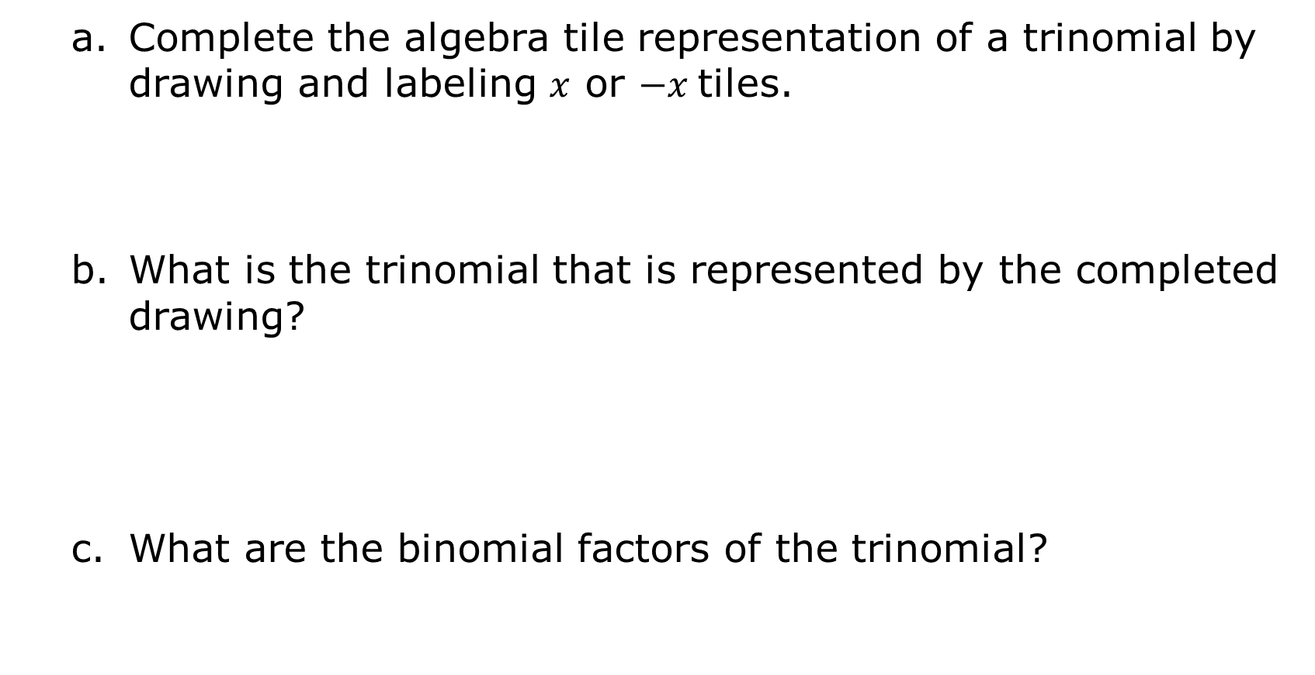
Complete the algebra tile representation of a trinomial by drawing and labeling $x$ or $−x$ tiles.
What is the trinomial that is represented by the completed drawing?
What are the binomial factors of the trinomial?
volume 1, pg. 366

Slide 19
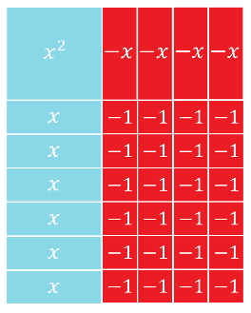
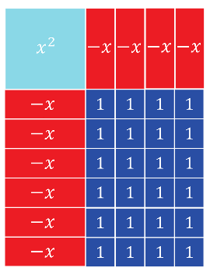
The algebra tile representation of two different trinomials is shown.
Complete the table.
Algebra Tiles | Trinomial | Factors
volume 1, pg. 366

Slide 20

Each of the trinomials in the table has either twenty-four unit squares, ${}_{}^{+}1$, or twenty-four negative unit squares, ${}_{}^{−}1$. Also, each trinomial has some combination of four and six ${}_{}^{+}x$ or ${}_{}^{−}x$ tiles.
volume 1, pg. 366

Slide 21
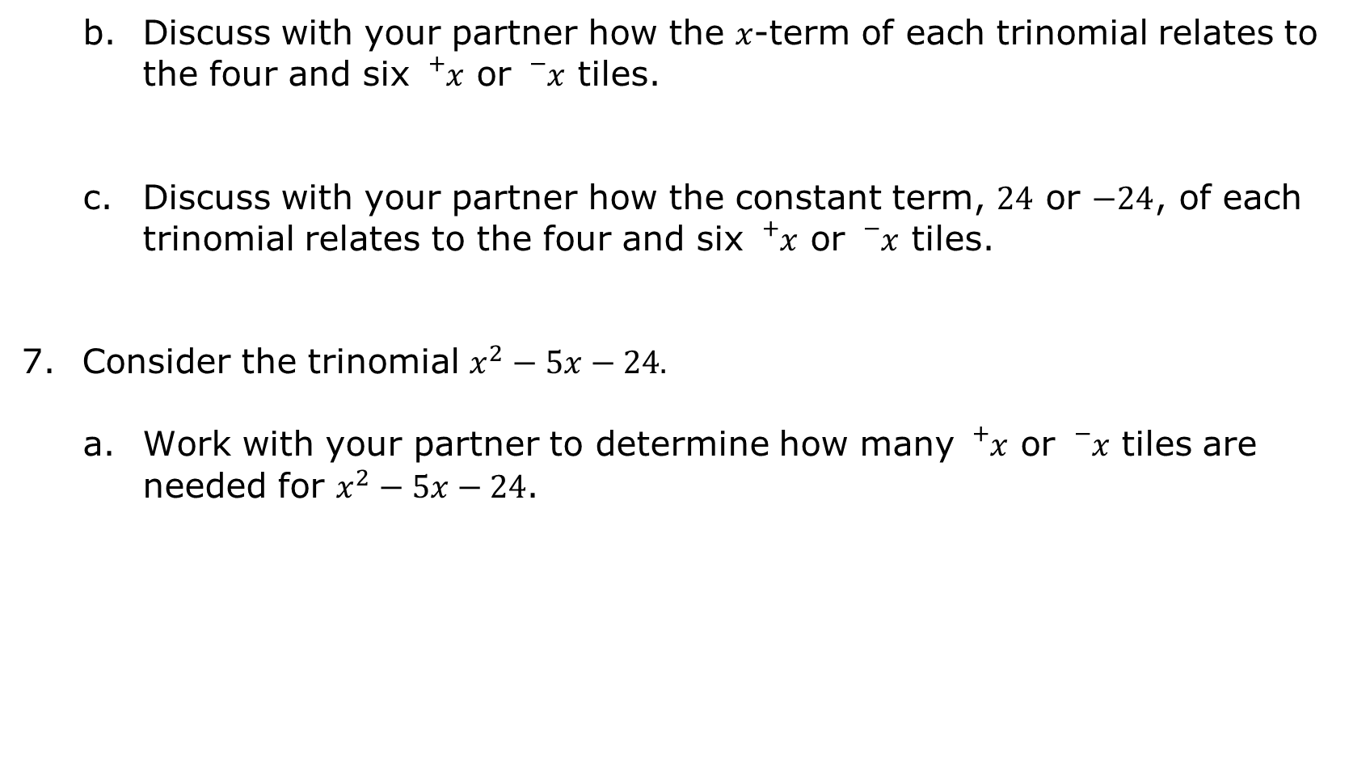
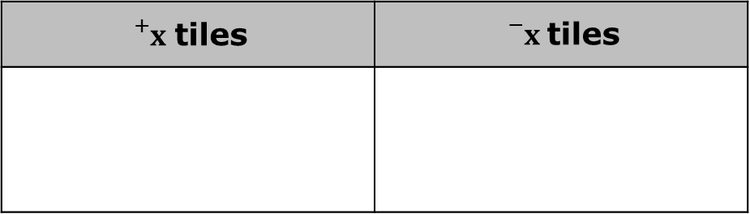
Discuss with your partner how the $x$-term of each trinomial relates to the four and six ${}_{}^{+}x$ or ${}_{}^{−}x$ tiles.
Discuss with your partner how the constant term, $24$ or $−24$, of each trinomial relates to the four and six ${}_{}^{+}x$ or ${}_{}^{−}x$ tiles.
Consider the trinomial $x^{2}−5x−24.$
Work with your partner to determine how many ${}_{}^{+}x$ or ${}_{}^{−}x$ tiles are needed for $x^{2}−5x−24$.
${}_{}^{+}x$ tiles | ${}_{}^{−}x$ tiles
volume 1, pg. 367

Slide 22

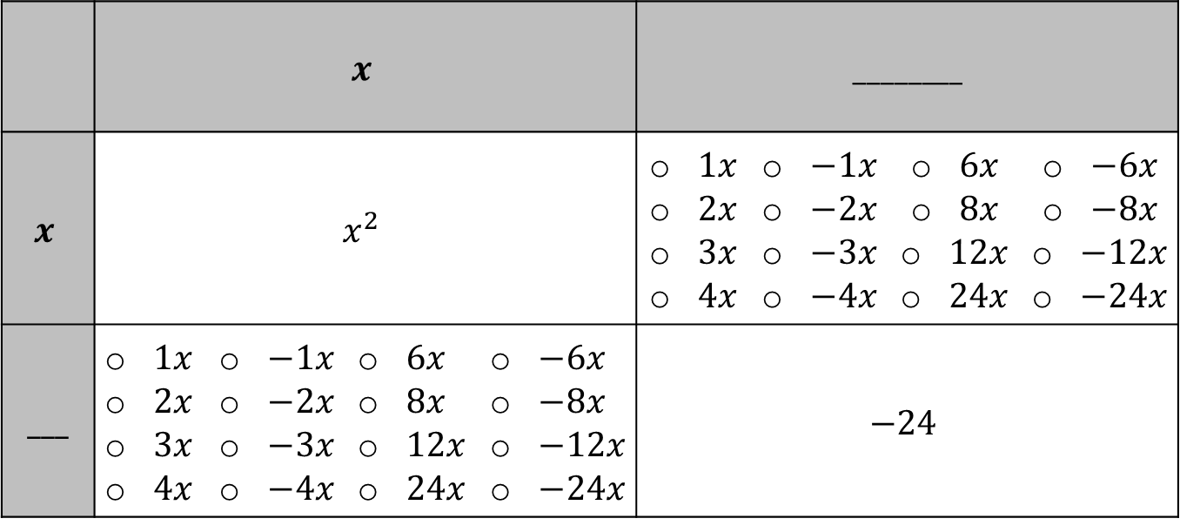
Draw a diagram of the algebra tiles that show the trinomial $x^{2}−5x−24$.
Use your algebra tiles diagram to choose the number of ${}_{}^{+}x$ or ${}_{}^{−}x$ tiles that match your diagram. Then, fill in each blank with the appropriate values.
 | $$x$$ |  |  |  | ________
$$x$$ | $$x^{2}$$ |  |  |  | $1x$ $2x$ $3x$ $4x$ | $−1x$ $−2x$ $−3x$ $−4x$ | $6x$ $8x$ $12x$ $24x$ | $−6x$ $−8x$ $−12x$ $−24x$
___ | $1x$ $2x$ $3x$ $4x$ | $−1x$ $−2x$ $−3x$ $−4x$ | $6x$ $8x$ $12x$ $24x$ | $−6x$ $−8x$ $−12x$ $−24x$ | $$−24$$
volume 1, pg. 367

Slide 23

Discuss with your partner how using the factors of $−24$, and the value of the coefficient of the $b$-term, $−5$, is helpful when factoring the trinomial $x^{2}−5x−24$. Summarize your discussion.
volume 1, pg. 367

Slide 24

Guided Practice
volume 1, pg. 368

Slide 25


7.2.3 Guided Practice: Factoring Trinomials
Complete the table for $x^{2}+18x−40$.
 | $$x$$ |  |  |  | ________
$$x$$ | $$x^{2}$$ |  |  |  | $1x$ $2x$ $4x$ $5x$ | $−1x$ $−2x$ $−4x$ $−5x$ | $8x$ $10x$ $20x$ $40x$ | $−8x$ $−10x$ $−20x$ $−40x$
___ | $1x$ $2x$ $4x$ $5x$ | $−1x$ $−2x$ $−4x$ $−5x$ | $8x$ $10x$ $20x$ $40x$ | $−8x$ $−10x$ $−20x$ $−40x$ | $$−40$$
volume 1, pg. 368

Slide 26
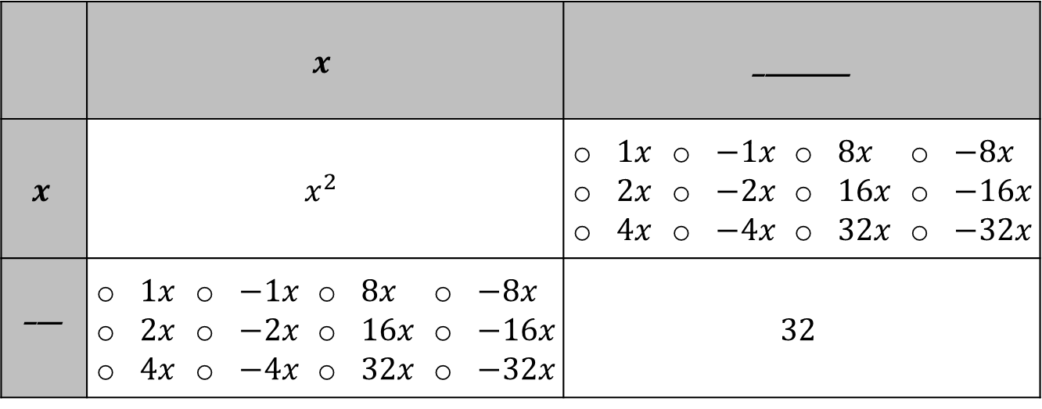
Complete the table for $x^{2}+12x+32$.
 | $$x$$ |  |  |  | ________
$$x$$ | $$x^{2}$$ |  |  |  | $1x$ $2x$ $4x$ | $−1x$ $−2x$ $−4x$ | $8x$ $16x$ $32x$ | $−8x$ $−16x$ $−32x$
___ | $1x$ $2x$ $4x$ | $−1x$ $−2x$ $−4x$ | $8x$ $16x$ $32x$ | $−8x$ $−16x$ $−32x$ | $$32$$
volume 1, pg. 368

Slide 27

Your Turn
volume 1, pg. 368

Slide 28

7.2.4 Your Turn!
Complete the table for $x^{2}−11x+18$.
 | $$x$$ |  |  |  | ____
$$x$$ | $$x^{2}$$ |  |  |  | $1x$ $2x$ $3x$ | $−1x$ $−2x$ $−3x$ | $6x$ $9x$ $18x$ | $−6x$ $−9x$ $−18x$
$$____$$ | $1x$ $2x$ $3x$ | $−1x$ $−2x$ $−3x$ | $6x$ $9x$ $18x$ | $−6x$ $−9x$ $−18x$ | $$18$$
volume 1, pg. 368

Slide 29

Wrap-Up
volume 1, pg. 369

Slide 30

7.2.5 Wrap-Up: Reflection
How “in the zone” do you feel right now about factoring trinomials?
volume 1, pg. 369

